Slide 1
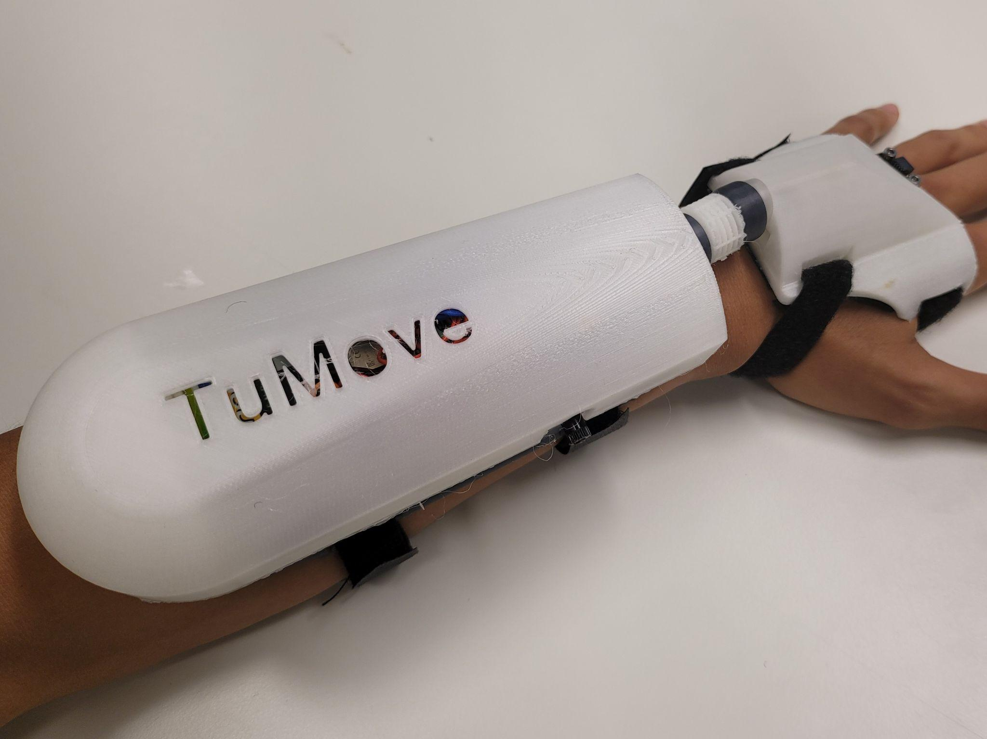
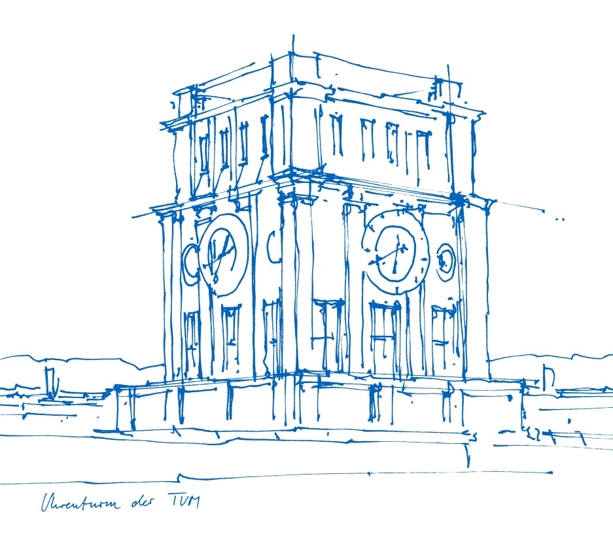
Damping Wrist Joint Tremors with Low Cost Soft Robotics
For the lecture:
Human-centered Neuroengineering:
Neurorehabilitation
Presented by team 5:
Thien Le
Jose Garcia
Klara Tomaskovic
Benoit Auclair
Supervisors:
Natalia Paredes Acuna, Nicolas Berberich
Technical University of Munich
Chair for Cognitive Systems
Prof. Dr. Gordon Cheng
2022-07-29

Slide 2
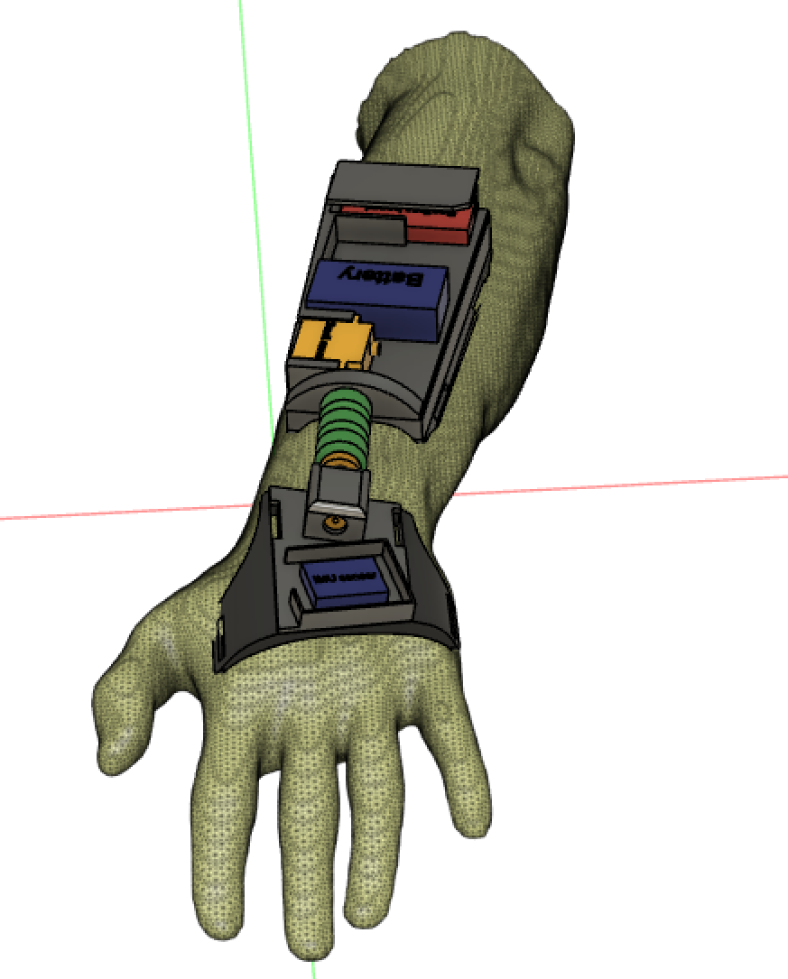
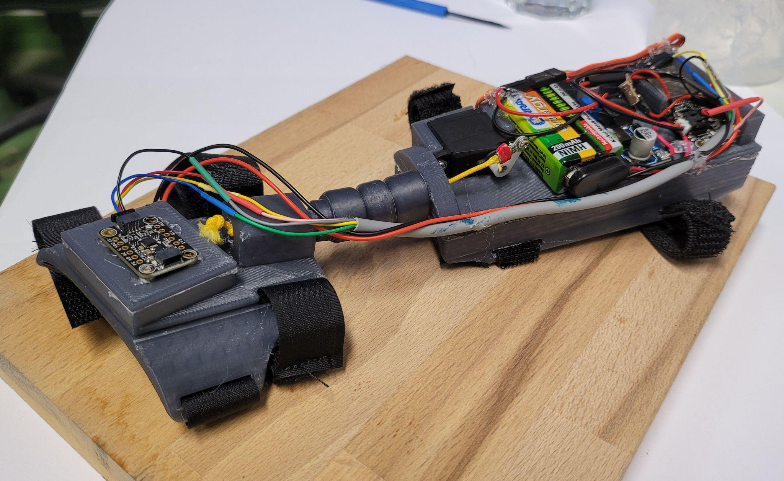
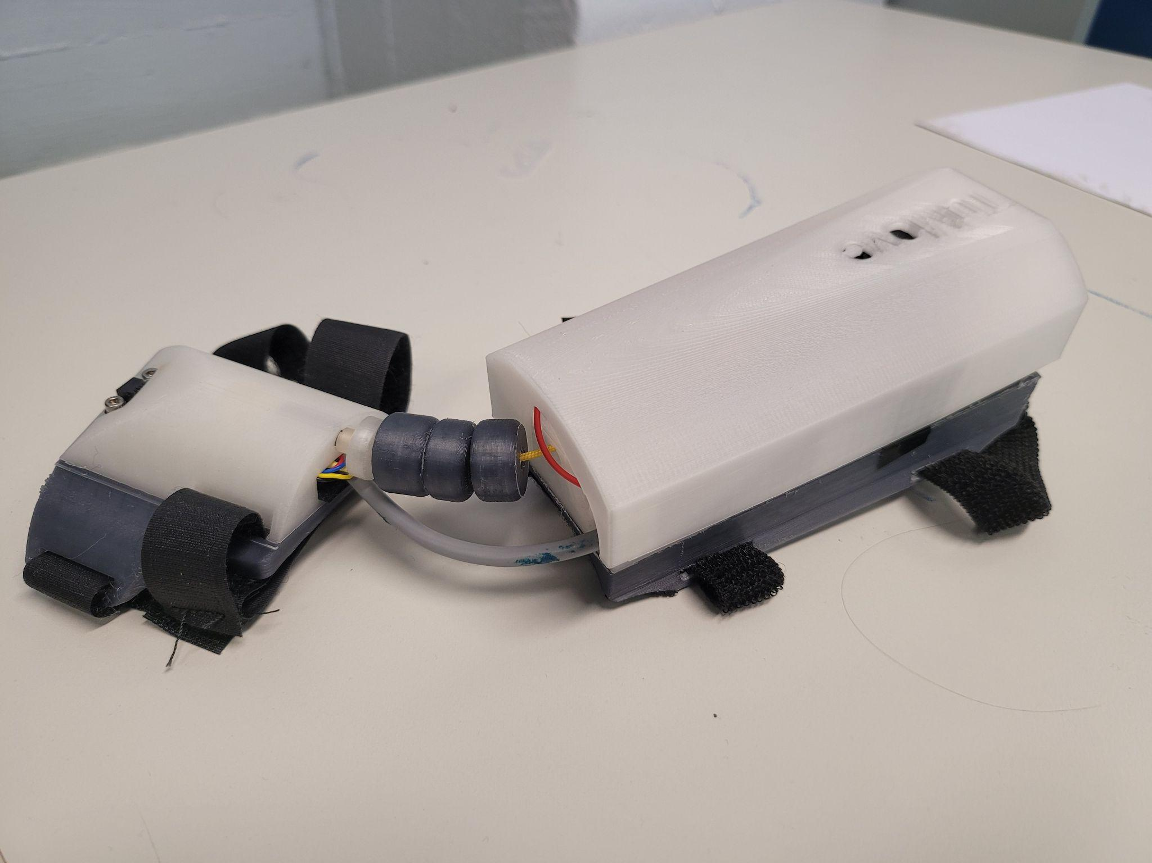
Introduction
It’s been a long way…
Definition of the problem
Detection and attenuation of intention tremors at the wrist joint
Concept + model + first rough prototype
TENS stimulation trials
Definition of the problem
Detection and attenuation of tremors at the wrist joint
Second prototype + final design
Functional actuation
Final prototype
Signal processing & control scheme
2 experiments
Results & conclusion
Project update
2022-07-08
Project update
2022-07-22
Final presentation
2022-07-29
Stay tuned
Mechanical Design | TuMove |
‹#›

Slide 3
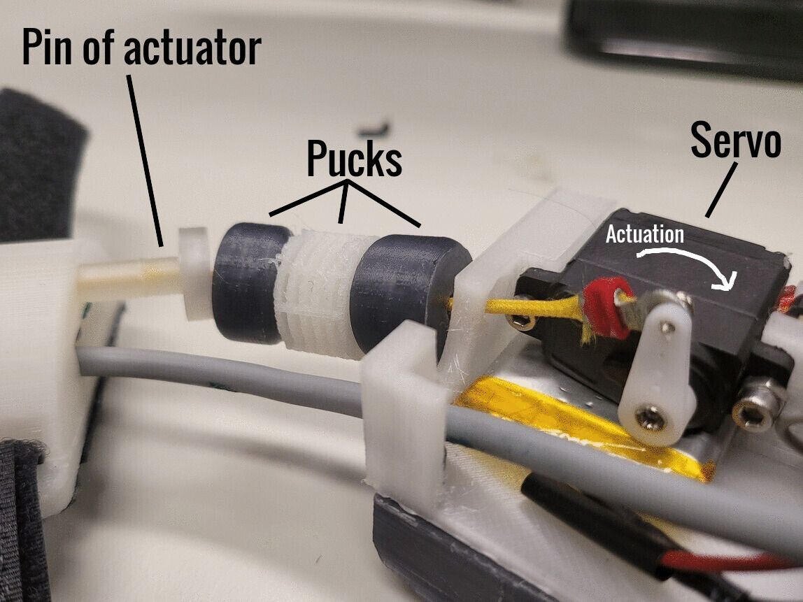
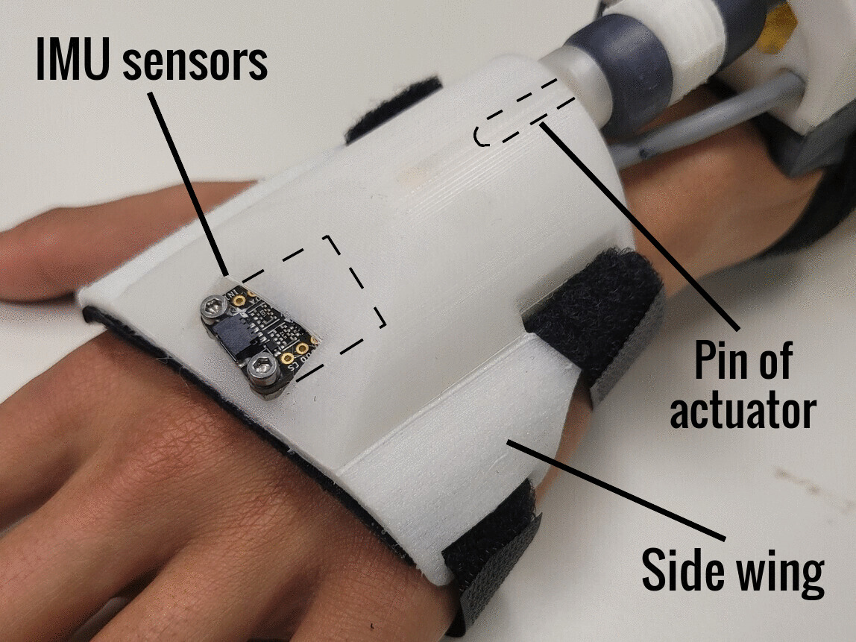
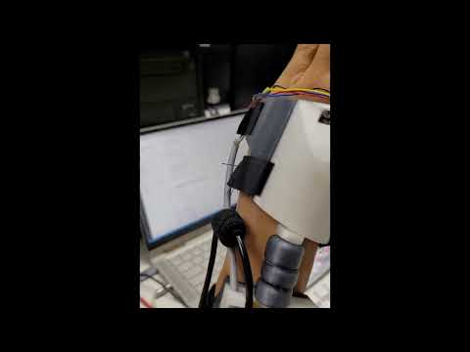
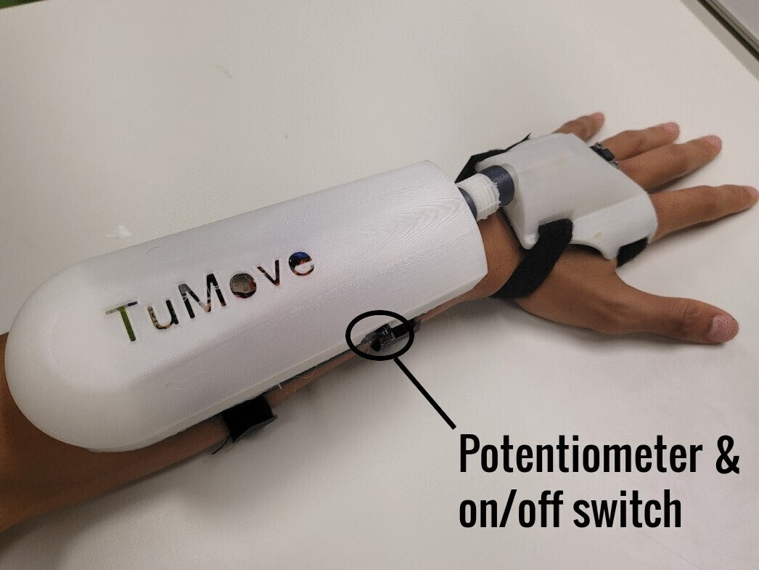
Mechanical Design
Mechanical Design | TuMove |
‹#›

Slide 4
Signal Processing
y axis of the gyroscope is perpendicular to flexion/extension
discrete Fourier transform to perform frequency analysis
RMS over tremor-related frequencies and over N sampling periods for robustness
Gyroscope Y-axis
@ 40 Hz
DFT
with N = 16
∆ f = 2.5 Hz
RMS
of DFT coefficients
7.5 - 12.5 Hz
RMS
over the past N=5 samples
PD Controller
Signal Processing | TuMove |
‹#›

Slide 5
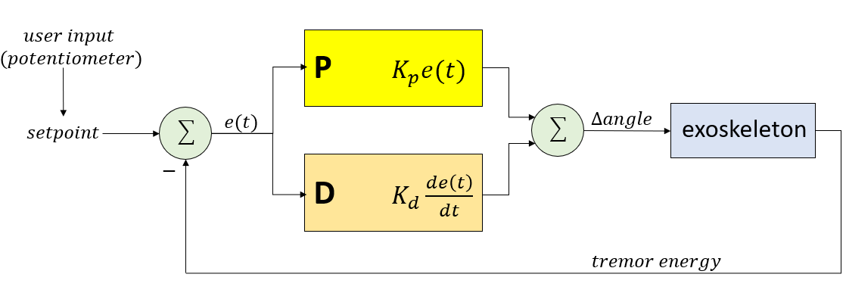
PID controller
Signal Processing | TuMove |
‹#›

Slide 6
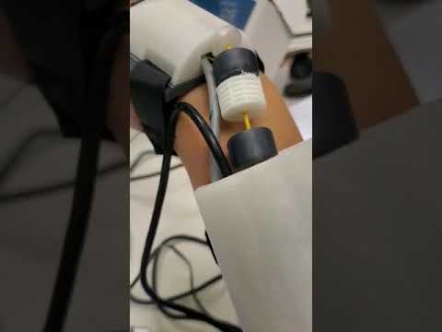
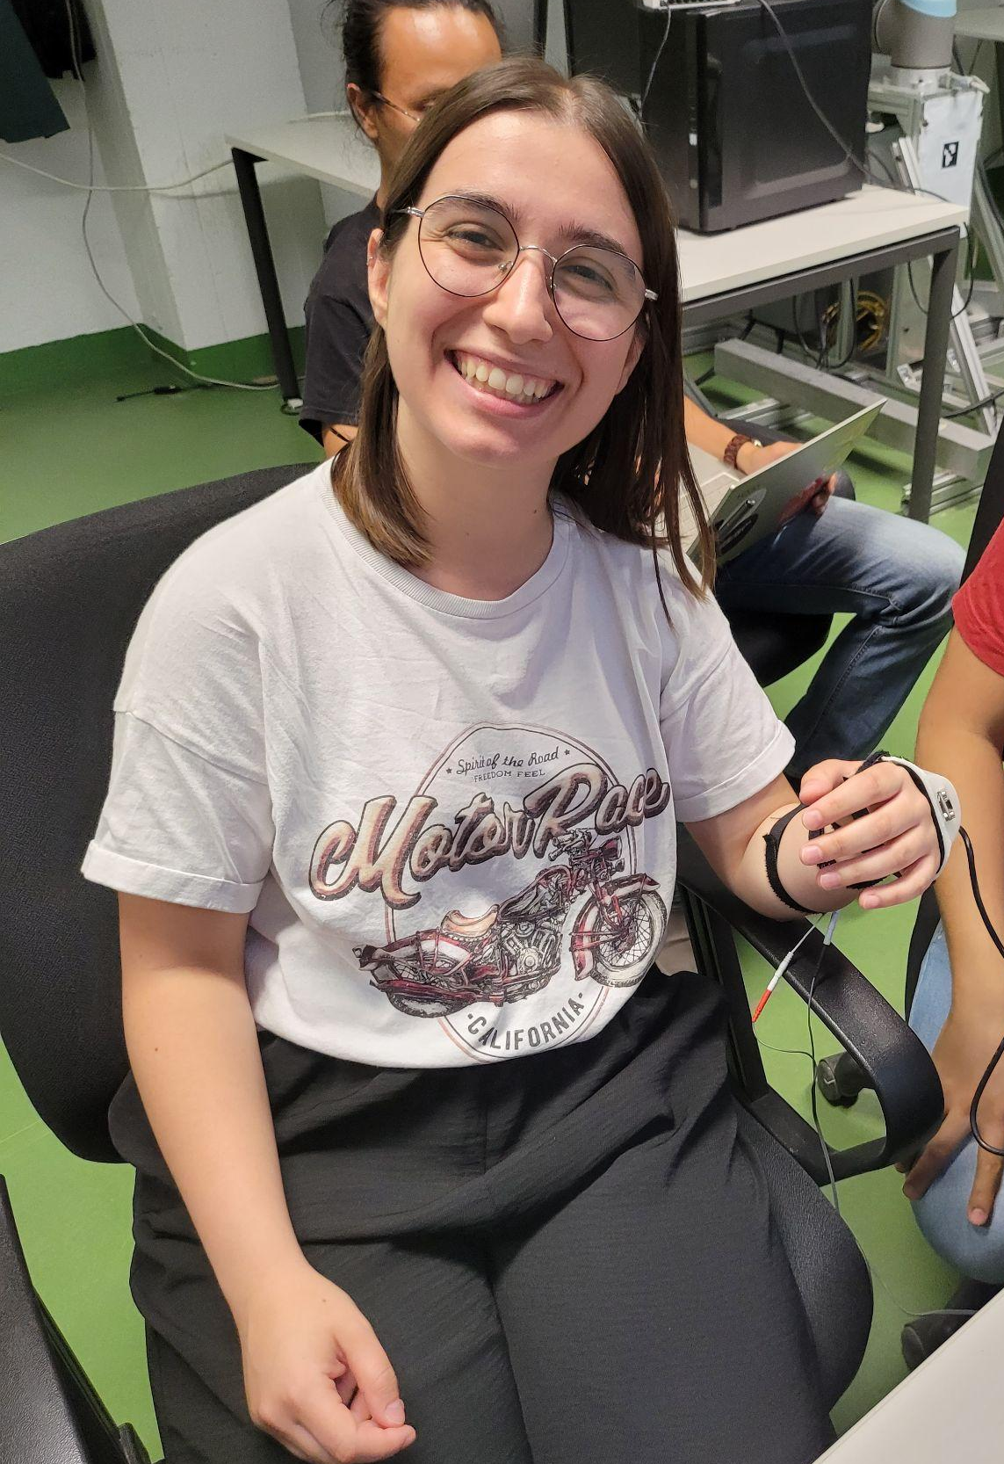
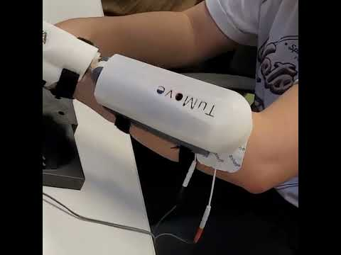
Experiments
Free wrist
Nine-Hole peg Test
Experimental results | TuMove |
‹#›
Notes:
Participant ages from 23 - 36 , 3 male and 2 female

Slide 7
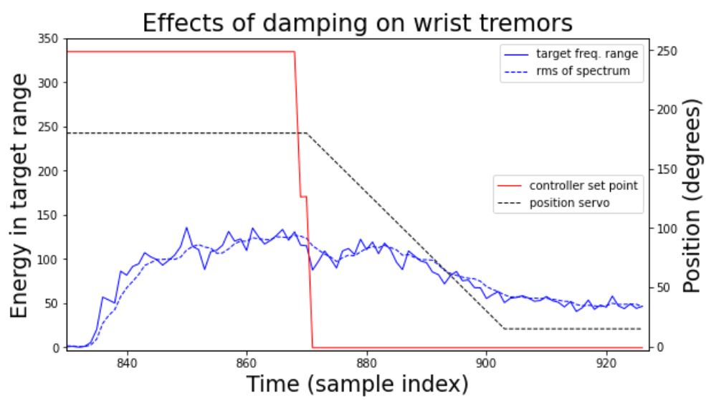
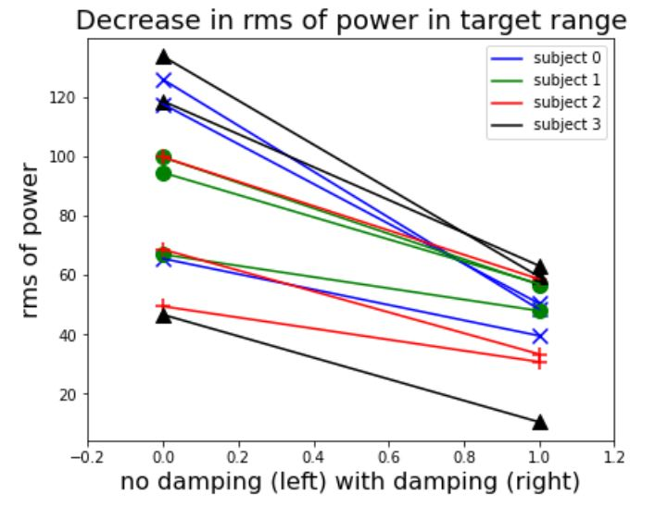
Results - Experiment 1
Metrics: mean rms of spectral energy over a window of n = 20 samples
Across all 4 subjects and all 3 trials the device showed 48% decrease in spectral energy in the target band
Experimental results | TuMove |
‹#›

Slide 8
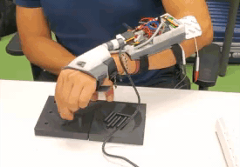
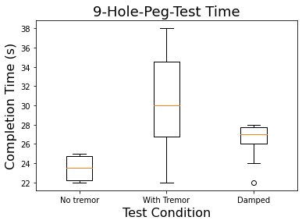
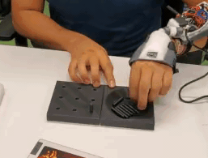
Results - Experiment 2
Experimental results | TuMove |
‹#›

Slide 9
Summary
An IMU-based tremor detection
Novel Soft Robotics Actuator Linkage
Portable, lightweight, comfortable, and compact unit
–> Device damps tremor energy up to 48% of artificial tremor
Thanks for listening
Q & A | TuMove |
‹#›
Notes:
40 grams heavier than a big Mac.

Slide 10
Demo
Thanks for listening - Q&A
Live demo | TuMove |
‹#›

Slide 11
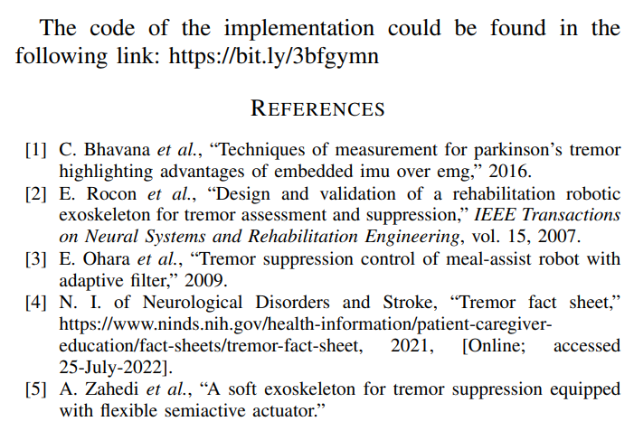
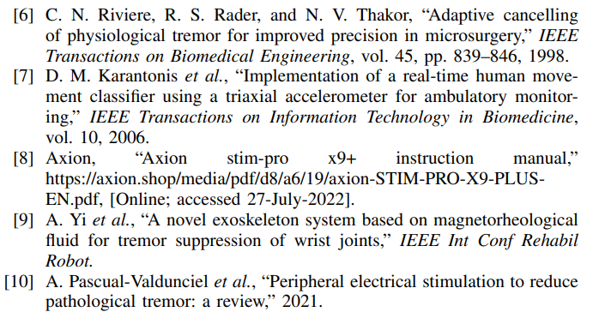
References
References | TuMove |
‹#›

